Slide 1
Trees 4: AVL Trees
Section 4.4

Slide 2
Motivation
When building a binary search tree, what type of trees would we like? Example: 3, 5, 8, 20, 18, 13, 22
3
5
13
8
5
20
13
18
3
8
18
22
20
22

Slide 3
Motivation
Complete binary tree is hard to build when we allow dynamic insert and remove.
  We want a tree that has the following properties
    Tree height = O(log(N))
    allows dynamic insert and remove with O(log(N)) time complexity.
  The AVL tree is one of this kind of trees.
8
13
5
18
5
20
3
13
20
3
8
18
22
22

Slide 4
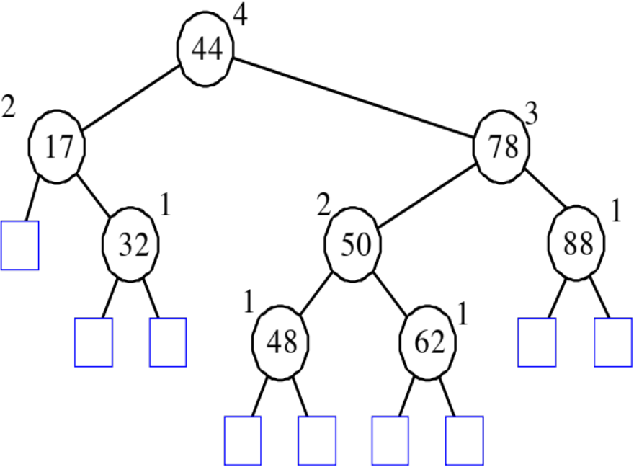
AVL (Adelson-Velskii and Landis) Trees
An AVL Tree is a binary search tree such that for every internal node v of T, the heights of the children of v can differ by at most 1.
An example of an AVL tree where the heights are shown next to the nodes:

Slide 5
AVL (Adelson-Velskii and Landis) Trees
AVL tree is a binary search tree with balance condition
  To ensure depth of the tree is O(log(N))
  And consequently, search/insert/remove complexity bound O(log(N))
Balance condition
  For every node in the tree, height of left and right subtree can differ by at most 1

Slide 6
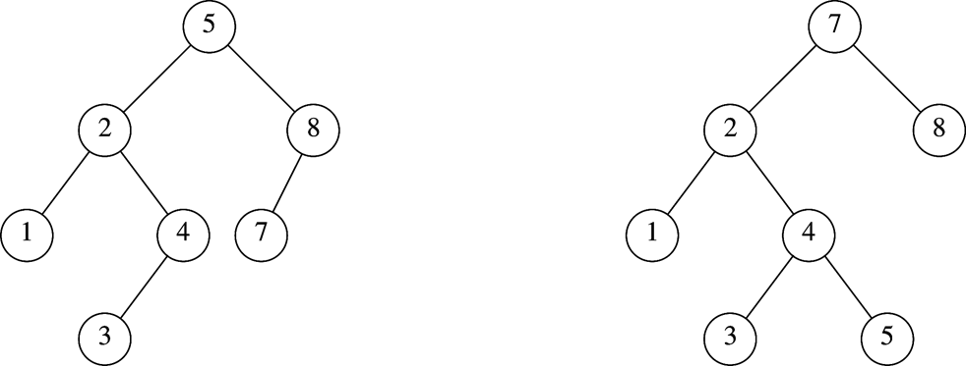
Which is an AVL Tree?

Slide 7
Height of an AVL tree
Theorem: The height of an AVL tree storing n keys is O(log n).
Proof:
  Let us bound n(h), the minimum number of internal nodes of an AVL tree of height h.
  We easily see that n(0) = 1 and n(1) = 2
  For h > 2, an AVL tree of height h contains the root node, one AVL subtree of height h-1 and another of height h-2 (at worst).
  That is, n(h) >= 1 + n(h-1) + n(h-2)
  Knowing n(h-1) > n(h-2), we get n(h) > 2n(h-2). So
    n(h) > 2n(h-2), n(h) > 4n(h-4), n(h) > 8n(n-6), … (by induction),
    n(h) > 2^{i}n(h-2i)
  Solving the base case we get: n(h) > 2 ^{h/2-1}
  Taking logarithms: h < 2log n(h) +2
  Since n>=n(h), h < 2log(n)+2 and the height of an AVL tree is O(log n)

Slide 8
AVL Tree Insert and Remove
Do binary search tree insert and remove
The balance condition can be violated sometimes
  Do something to fix it : rotations
  After rotations, the balance of the whole tree is maintained

Slide 9
Balance Condition Violation
If condition violated after a node insertion
  Which nodes do we need to rotate?
  Only nodes on path from insertion point to root may have their balance altered
Rebalance the tree through rotation at the deepest node with balance violated
  The entire tree will be rebalanced
Violation cases at node k (deepest node)
  An insertion into left subtree of left child of k
  An insertion into right subtree of left child of k
  An insertion into left subtree of right child of k
  An insertion into right subtree of right child of k
  Cases 1 and 4 equivalent
    Single rotation to rebalance
  Cases 2 and 3 equivalent
    Double rotation to rebalance

Slide 10
AVL Trees Complexity
Overhead
  Extra space for maintaining height information at each node
  Insertion and deletion become more complicated, but still O(log N)
Advantage
  Worst case O(log(N)) for insert, delete, and search

Slide 11
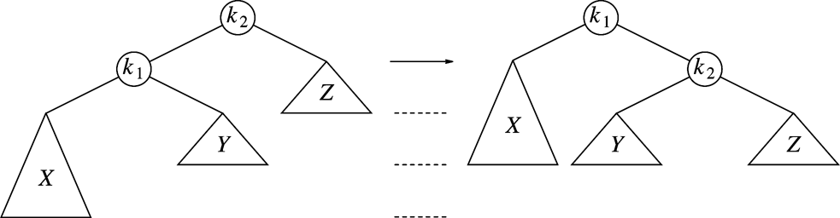
Single Rotation (Case 1)
Replace node k₂ by node k₁
Set node k₂ to be right child of node k₁
Set subtree Y to be left child of node k₂
Case 4 is similar

Slide 12
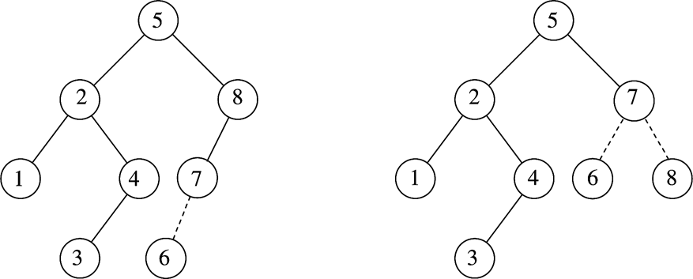
Example
After inserting 6
  Balance condition at node 8 is violated

Slide 13
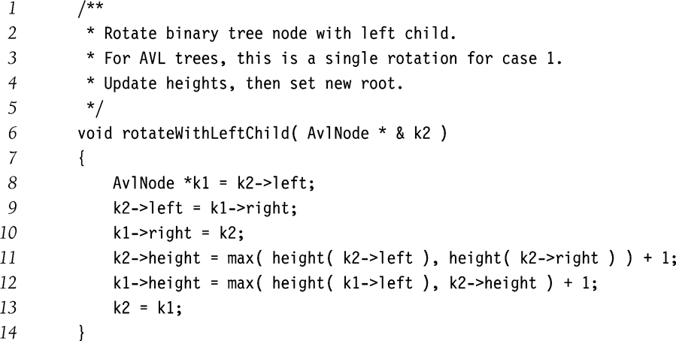
Single Rotation (Case 1)

Slide 14
Example
Inserting 3, 2, 1, and then 4 to 7 sequentially into empty AVL tree
3
2
2
1
3
1

Slide 15
Example (Cont’d)
Inserting 4
Inserting 5
2
1
3
4
2
2
1
3
4
1
4
5
3
5

Slide 16
Example (Cont’d)
Inserting 6
Inserting 7
4
2
2
5
1
4
1
3
6
3
5
6
4
4
2
6
2
5
1
3
5
7
1
3
6
7

Slide 17
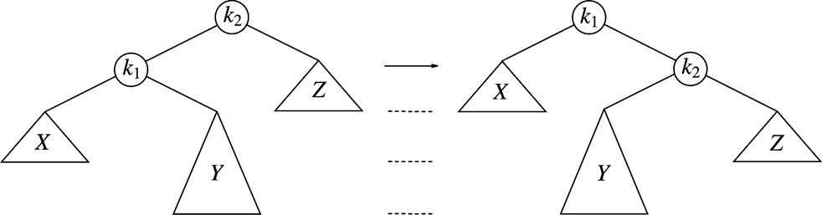
Single Rotation Will Not Work for the Other Case
For case 2
After single rotation, k₁ still not balanced
Double rotations needed for case 2 and case 3

Slide 18
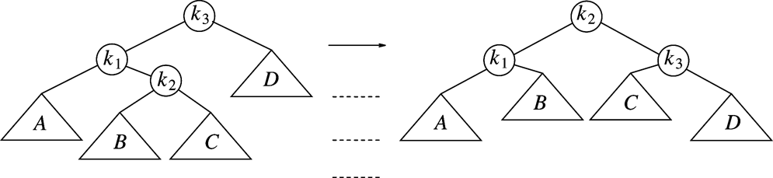
Double Rotation (Case 2)
Left-right double rotation to fix case 2
First rotate between k₁ and k₂
Then rotate between k₂ and k₃
Case 3 is similar

Slide 19
Example
Continuing the previous example by inserting
  16 down to 10, and then 8 and 9
Inserting 16 and 15
4
4
2
6
2
6
1
3
5
15
1
3
5
7
7
16
16
15

Slide 20
Example (Cont’d)
Inserting 14
Other cases as exercises
4
4
2
7
2
6
1
3
6
15
1
3
5
15
14
16
7
16
5
14

Slide 21
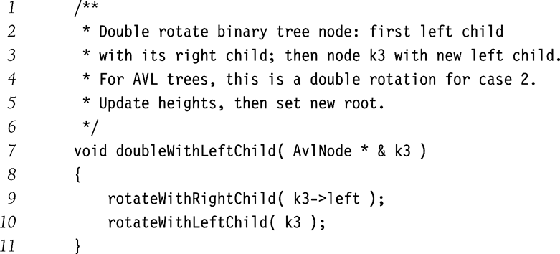
Double Rotation (Case 2)

Slide 22
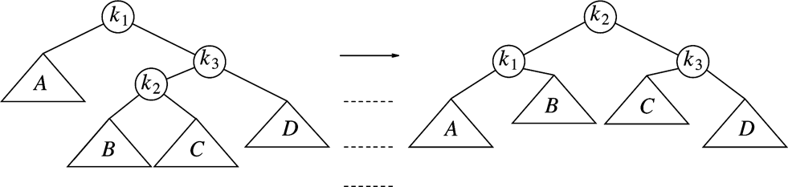
Summary
Violation cases at node k (deepest node)
  An insertion into left subtree of left child of k
  An insertion into right subtree of left child of k
  An insertion into left subtree of right child of k
  An insertion into right subtree of right child of k
Case 1
Case 2
Case 4?
Case 3

Slide 23
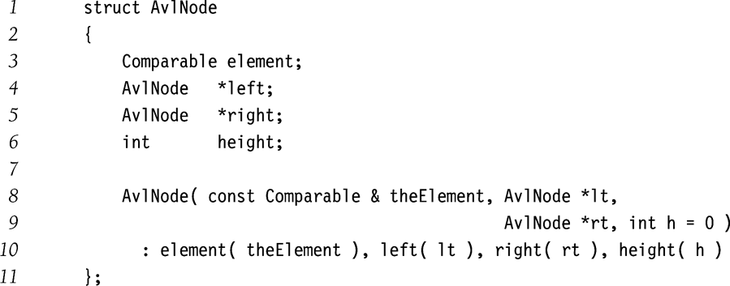
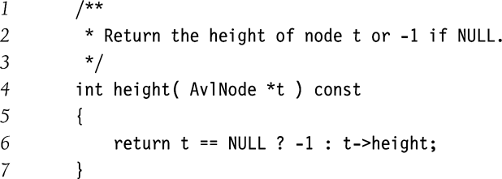
Implementation of AVL Tree

Slide 24
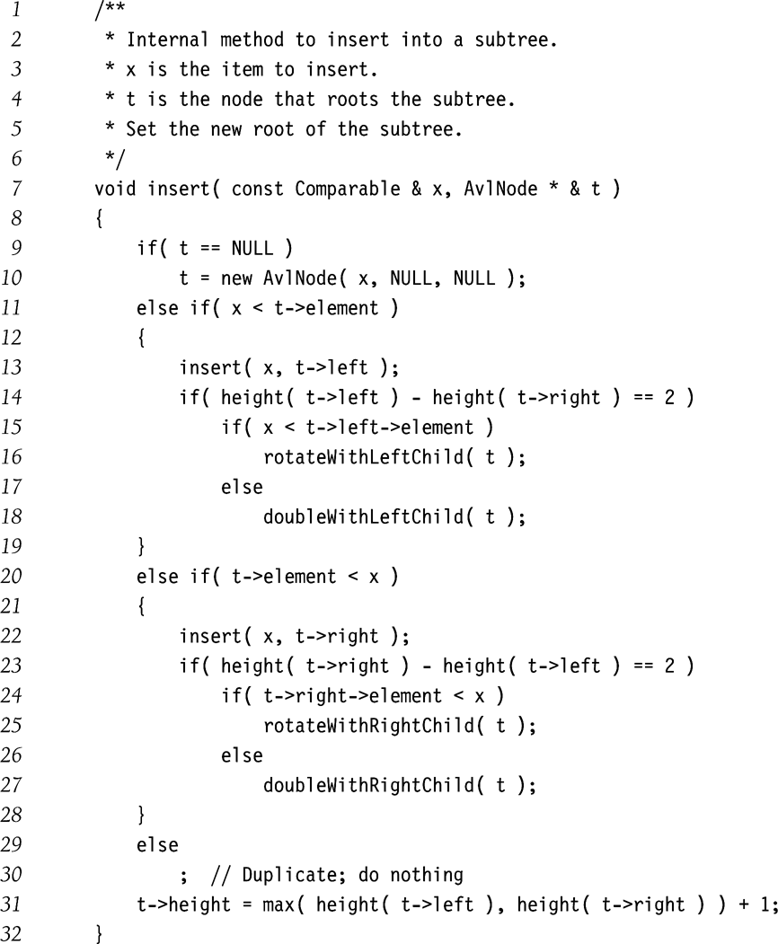
Case 1
Case 2
Case 4
Case 3

Slide 25
Single Rotation (Case 1)

Slide 26
Double Rotation (Case 2)

Slide 27
Review Insertion -- Case 1
h+2
h+1
Height = h
h
h
Before insert
h+2
h+1
h+2
h
h+1
h+1
h
h
h
After rotation
After insert

Slide 28
Review Insertion -- Case 2
Determine all heights
Height = h
Before insert
After insert
After double rotation

Slide 29
Delete -- Case 1
Consider deepest unbalanced node
  Case 1: Left child’s left side is too high
  Case 4: Right child’s right side is too high
  The parents may need to be recursively rotated
h+2
h+1
Height = h
h/h-1
h
Delete
Before Deletion
h+1/h+2
h/h+1
h+1
h-1
h
h/h-1
h/h-1
h-1
h
After single rotation
After delete

Slide 30
Delete -- Case 2
Consider deepest unbalanced node
  Case 2: Left child’s right side is too high
  Case 3: Right child’s left side is too high
  The parents may need to be recursively rotated
Height = h
Determine all heights
Delete
Before Deletion
After Delete
After double rotation

